Slide 1


What makes for a Happy Population:
an Economic, Social, and Citizen Opinions Investigation
Calvin Gao

Slide 2

Tidyverse
Literature Review
1
Past studies
dplyr
ggplot2
qacBase
Data Collection & Merge
2
Merge of two datasets
qacEDA
3
Final Dataset
Split into 3 sets for analysis
Parameter selection
Using PCA to select relevant variables
4
Modeling
5
Linear regression: fixed effects
Cluster Analysis
6
Exploring similar countries

Slide 3
Past studies
Split the final dataset
Literature Review
Data Collection & Merge
Final Dataset
Parameter selection
Modeling
Tidyverse
Happiness
Subjective well-being
Satisfaction
Utility
Well-being
Welfare
In developed nations, economic progress buys only a small amount of extra happiness.
(Oswald, 1997)
In Japan, improved conditions for groups targeted by reform correlated with increases in well-being.
(Sarracino et al., 2022)
dplyr
ggplot2
qacBase
01
qacEDA
Subjective well-being varies directly with income, inversely with material aspirations. At the start of the life cycle, higher income groups were happier since they were able to purchase more. However, income growth does not cause well-being to increase. With an increase in income, material aspirations increase relatively equivalent to income growth. The two relations cancel one another.
(Easterlin, 2001)
In Europe, happiness is negatively affected by unemployment rate. Spending social resources on unemployment protection and active labour policies have a positive impact on well-being.
(Bonasia et al., 2022)
There is enough evidence that individuals are able and willing to provide meaningful Self-Reported Happiness that leads to many new insights on individual happiness and motivations.
(Ferrer-i-Carbonell, 2013)
02
03
04
05
Merge of two datasets
Classifying similar variables and conducting a regression
Exploring similar countries

Slide 4
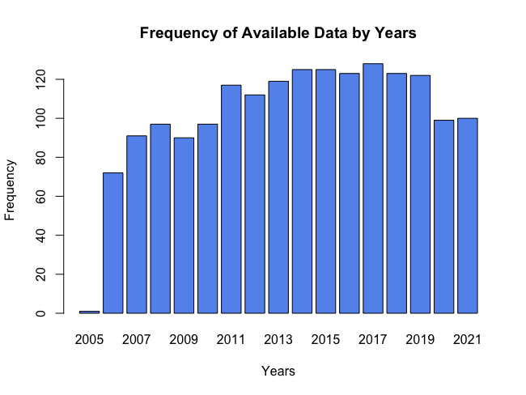
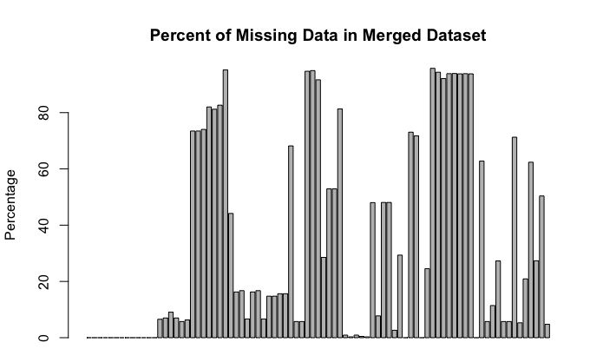
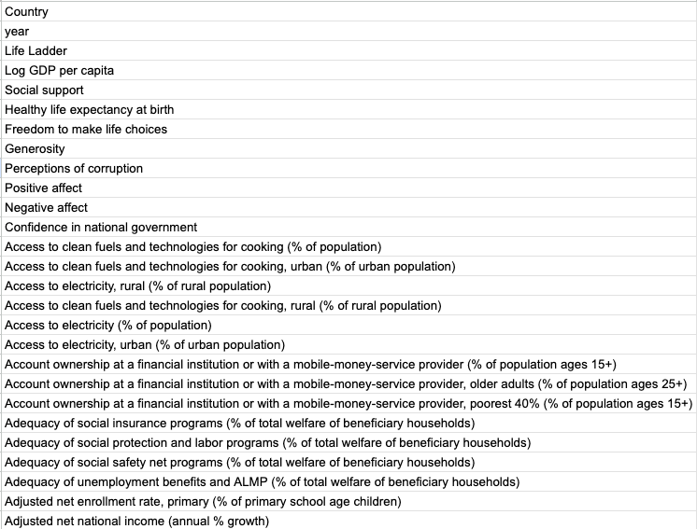
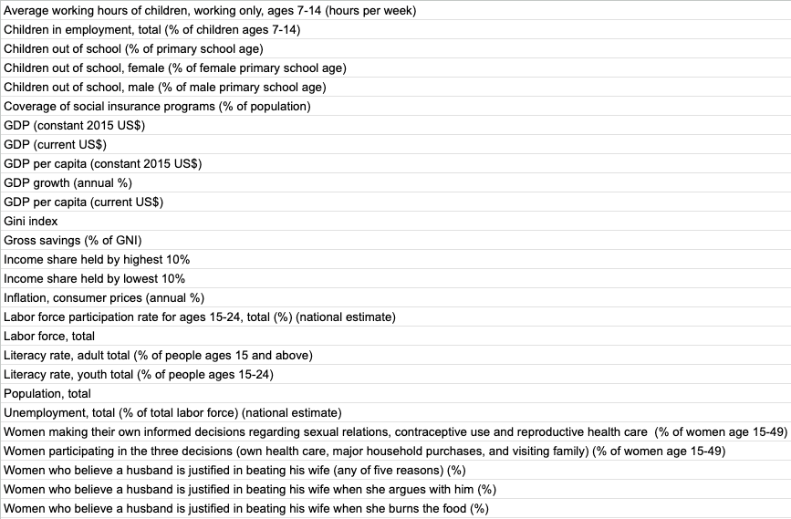
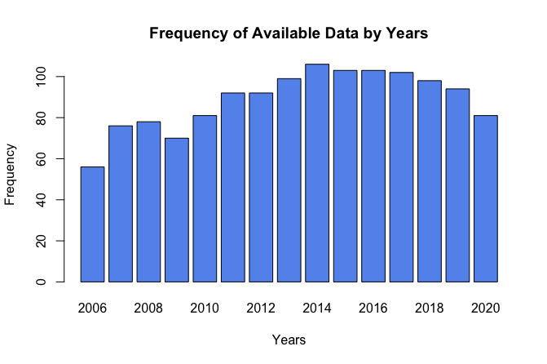
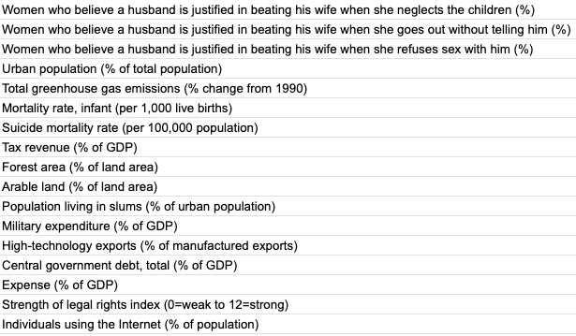

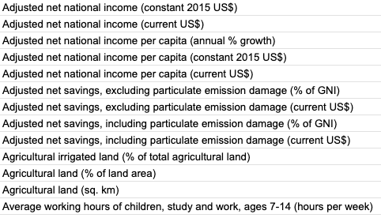

Past studies
Split the final dataset
Literature Review
Data Collection & Merge
Final Dataset
Parameter selection
Modeling
Tidyverse
Missing Data
dplyr
ggplot2
Removed variables with more than 10% missing
Removed remaining missing data
qacBase
Total of 83 Variables
01
qacEDA
02
Final Dataset 2006- 2020
38 Variables
1331 Observations
03
World Bank
2000-2021
72 Variables
World Happiness Report
2005-2021
12 Variables
04
05
Merge of two datasets
Classifying similar variables and conducting a regression
Exploring similar countries
Notes:
Merged by country

Slide 5
Literature Review
Data Collection & Merge
Final Dataset
Parameter selection
Modeling
Missing Data
Removed variables with more than 10% missing
Removed remaining missing data
84 Variables
1741 Observations
1340 Observations
Final Dataset 2006- 2020
37 Variables
1331 Observations

Slide 6
Literature Review
Data Collection & Merge
Final Dataset
Parameter selection
Modeling
Missing Data
Removed variables with more than 10% missing
Removed remaining missing data
84 Variables
1741 Observations
1340 Observations
Final Dataset 2006- 2020
37 Variables
1331 Observations

Slide 7
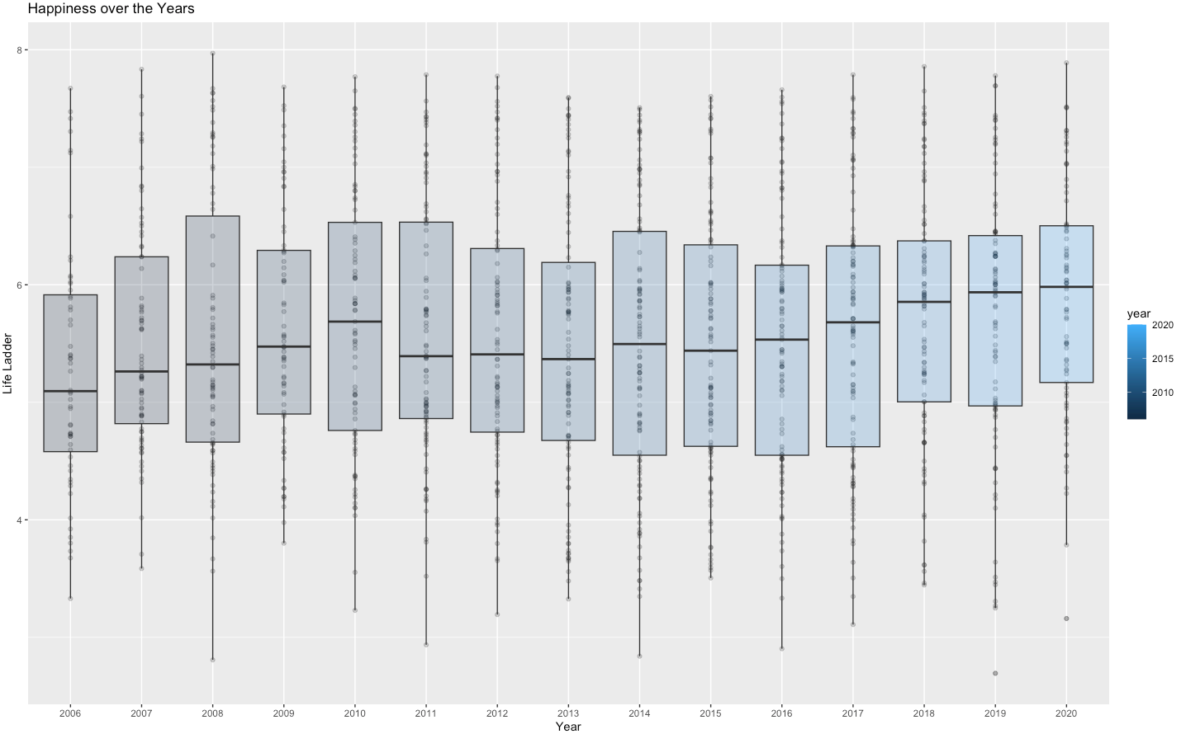
Literature Review
Data Collection & Merge
Final Dataset
Parameter selection
Modeling
Happiness Over the Years
8
Happiness (DV)
Life ladder: Imagine yourself on a ladder, from 0 (worse) - 10, which step are you on now
“Please imagine a ladder, with steps numbered from 0 at the bottom to 10 at the top. The top of the ladder represents the best possible life for you and the bottom of the ladder represents the worst possible life for you. On which step of the ladder would you say you personally feel you stand at this time?”
7
6
Happiness
5
4
3
Year
Zimbabwe

Slide 8
Literature Review
Data Collection & Merge
Final Dataset
Parameter selection
Modeling
Happiness Over the Years
8
Happiness (DV)
Life ladder: Imagine yourself on a ladder, from 0 (worse) - 10, which step are you on now
“Please imagine a ladder, with steps numbered from 0 at the bottom to 10 at the top. The top of the ladder represents the best possible life for you and the bottom of the ladder represents the worst possible life for you. On which step of the ladder would you say you personally feel you stand at this time?”
7
6
Happiness
5
4
3
Zimbabwe
Social (14 Variables)
Economic (20 Variables)
Year
Country
Region
year
Life Ladder
Access to clean fuels and technologies for cooking (% of population)
Access to clean fuels and technologies for cooking, urban (% of urban population)
Access to electricity, rural (% of rural population)
Access to clean fuels and technologies for cooking, rural (% of rural population)
Access to electricity (% of population)
Access to electricity, urban (% of urban population)
Urban population (% of total population)
Forest area (% of land area)
Arable land (% of land area)
Individuals using the Internet (% of population)
Country
Region
year
Life Ladder
Log GDP per capita
Adjusted net national income (current US$)
Adjusted net national income per capita (current US$)
Agricultural land (% of land area)
Agricultural land (sq. km)
GDP (constant 2015 US$)
GDP (current US$)
GDP per capita (constant 2015 US$)
GDP growth (annual %)
GDP per capita (current US$)
Gross savings (% of GNI)
Inflation, consumer prices (annual %)
Labor force, total
Population, total
Mortality rate, infant (per 1,000 live births)
Military expenditure (% of GDP)
Citizen opinions (12 Variables)
Country
Region
year
Life Ladder
Social support
Healthy life expectancy at birth
Freedom to make life choices
Generosity
Perceptions of corruption
Positive affect
Negative affect
Confidence in national government

Slide 9
Literature Review
Data Collection & Merge
Final Dataset
Parameter selection
Modeling
Economic (19 Variables)
Citizen opinions (11 Variables)
Social (13 Variables)
Country
year
Life Ladder
Log GDP per capita
Adjusted net national income (current US$)
Adjusted net national income per capita (current US$)
Agricultural land (% of land area)
Agricultural land (sq. km)
GDP (constant 2015 US$)
GDP (current US$)
GDP per capita (constant 2015 US$)
GDP growth (annual %)
GDP per capita (current US$)
Gross savings (% of GNI)
Inflation, consumer prices (annual %)
Labor force, total
Population, total
Mortality rate, infant (per 1,000 live births)
Military expenditure (% of GDP)
Country
year
Life Ladder
Access to clean fuels and technologies for cooking (% of population)
Access to clean fuels and technologies for cooking, urban (% of urban population)
Access to electricity, rural (% of rural population)
Access to clean fuels and technologies for cooking, rural (% of rural population)
Access to electricity (% of population)
Access to electricity, urban (% of urban population)
Urban population (% of total population)
Forest area (% of land area)
Arable land (% of land area)
Individuals using the Internet (% of population)
Country
year
Life Ladder
Social support
Healthy life expectancy at birth
Freedom to make life choices
Generosity
Perceptions of corruption
Positive affect
Negative affect
Confidence in national government

Slide 10
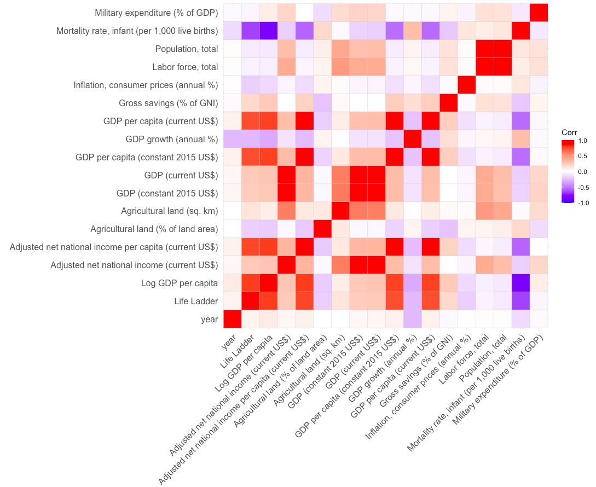
Literature Review
Data Collection & Merge
Final Dataset
Parameter selection
Modeling
Economic (19 Variables)
Country
year
Life Ladder
Log GDP per capita
Adjusted net national income (current US$)
Adjusted net national income per capita (current US$)
Agricultural land (% of land area)
Agricultural land (sq. km)
GDP (constant 2015 US$)
GDP (current US$)
GDP per capita (constant 2015 US$)
GDP growth (annual %)
GDP per capita (current US$)
Gross savings (% of GNI)
Inflation, consumer prices (annual %)
Labor force, total
Population, total
Mortality rate, infant (per 1,000 live births)
Military expenditure (% of GDP)

Slide 11
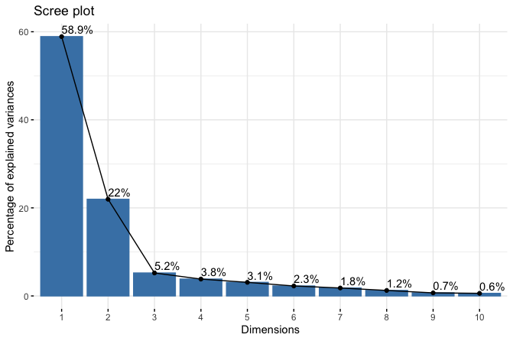
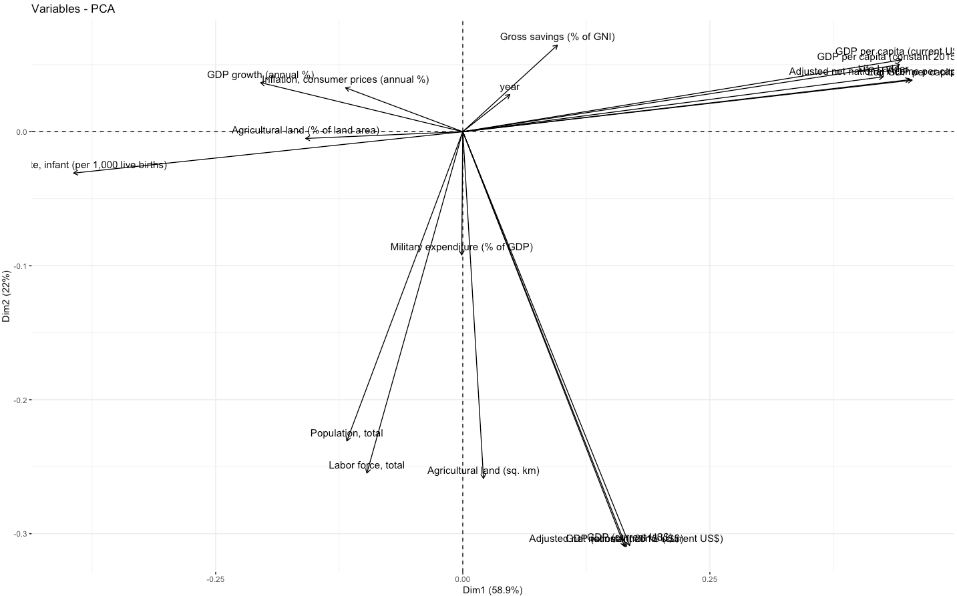
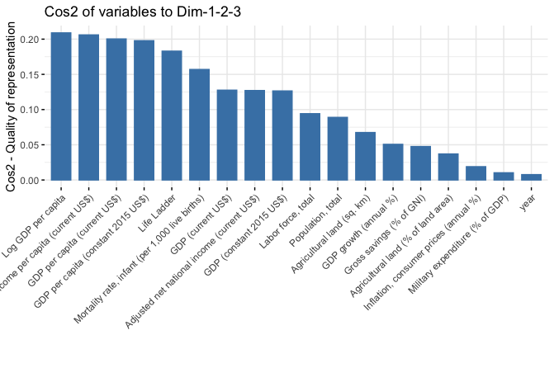
Literature Review
Data Collection & Merge
Final Dataset
Parameter selection
Modeling
Economic (19 Variables)

Slide 12
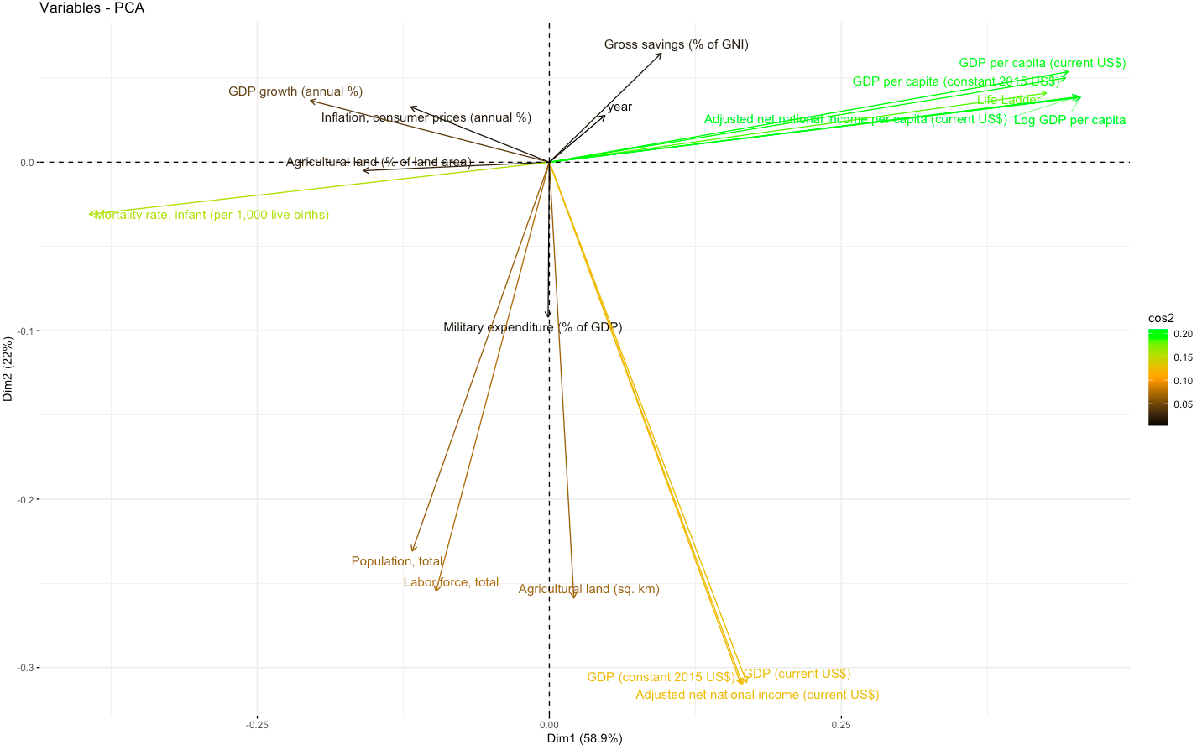
Literature Review
Data Collection & Merge
Final Dataset
Parameter selection
Modeling
Economic (19 Variables)
Gross Savings (% of GNI)
GDP growth (annual %)
Log GDP per Capita
Inflation, consumer prices (annual %)
Mortality rate, infant (per 1,000 live births)
Labor force, total
Agriculture land (sq. km)

Slide 13
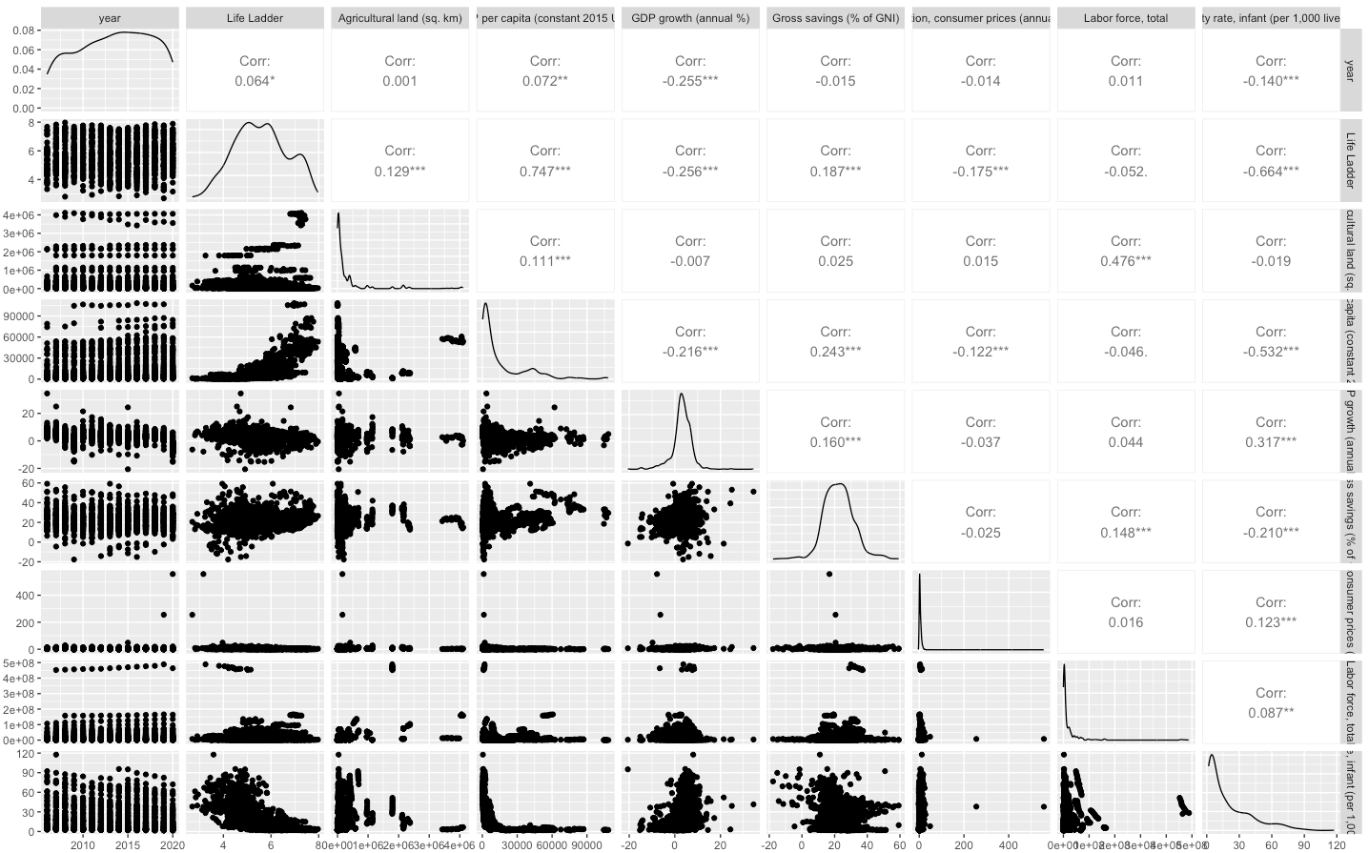
Literature Review
Data Collection & Merge
Final Dataset
Parameter selection
Modeling
Economic (10 Variables)

Slide 14
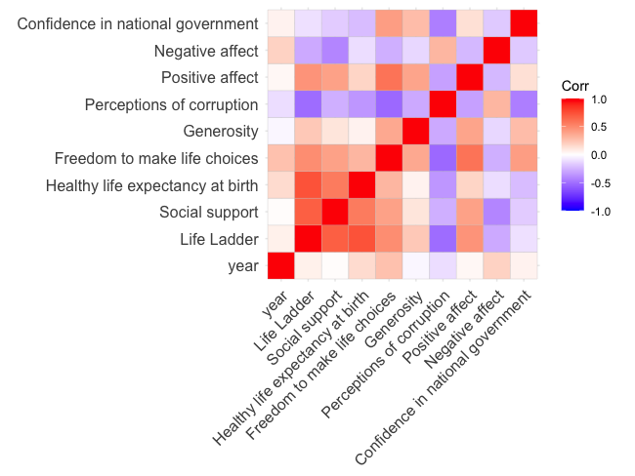
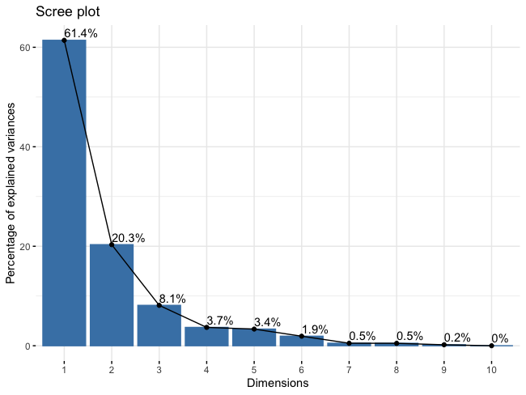
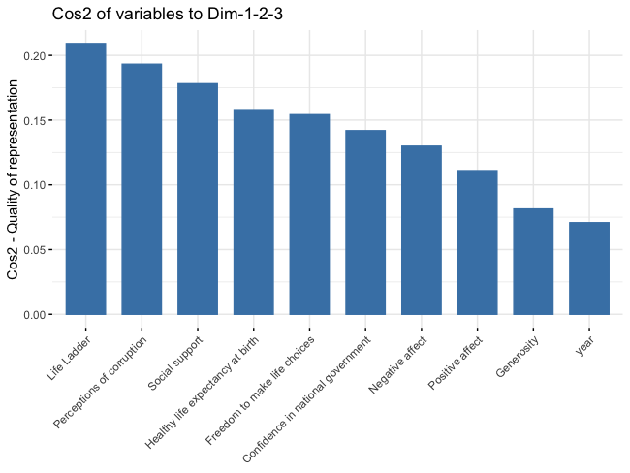
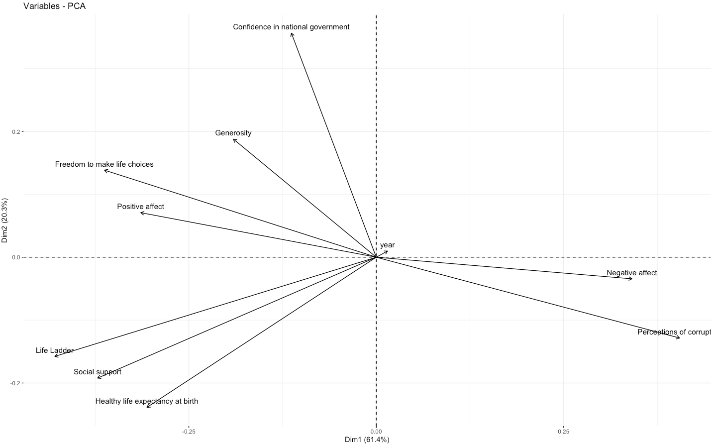
Literature Review
Data Collection & Merge
Final Dataset
Parameter selection
Modeling
Citizen opinions (11 Variables)
Country
year
Life Ladder
Social support
Healthy life expectancy at birth
Freedom to make life choices
Generosity
Perceptions of corruption
Positive affect
Negative affect
Confidence in national government

Slide 15
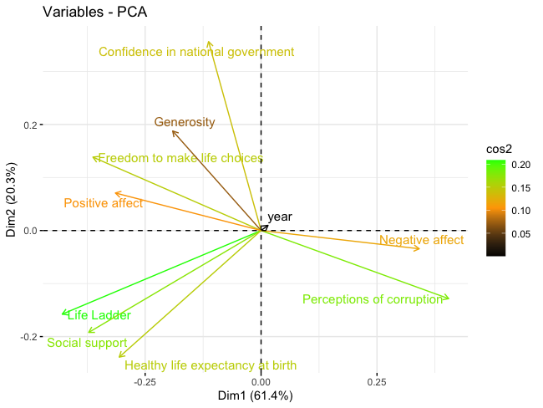
Literature Review
Data Collection & Merge
Final Dataset
Parameter selection
Modeling
Citizen opinions (11 Variables)

Slide 16
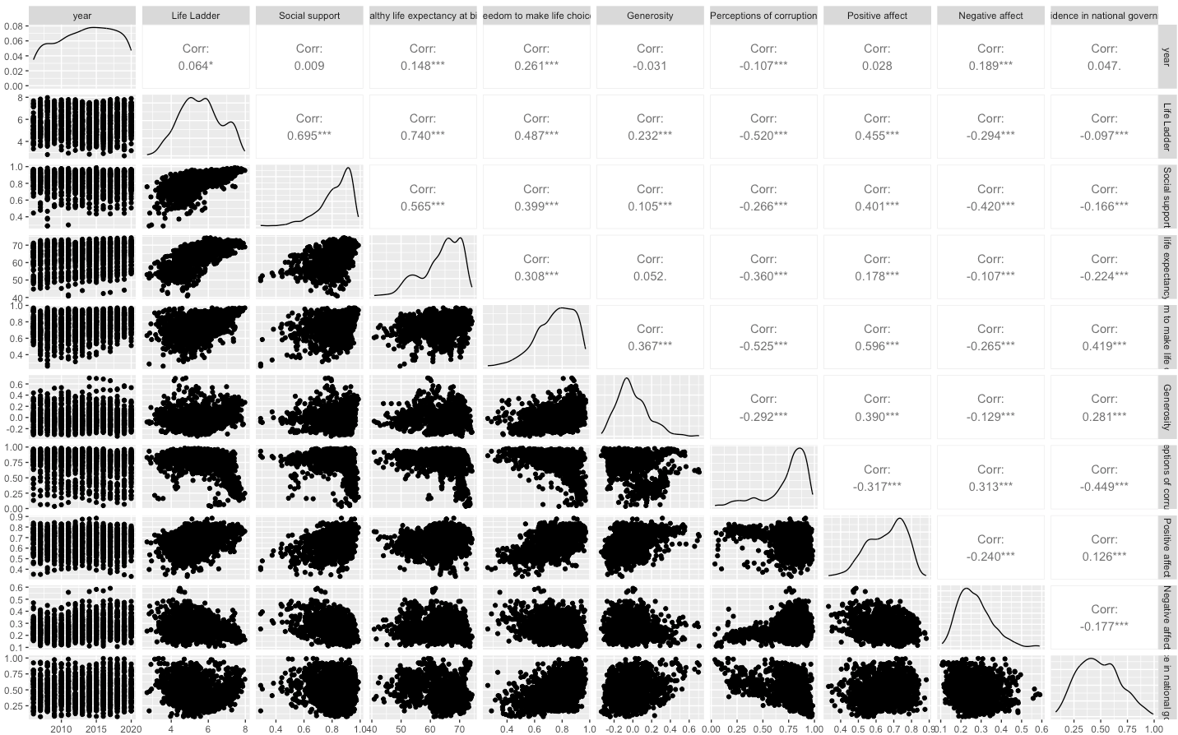
Literature Review
Data Collection & Merge
Final Dataset
Parameter selection
Modeling
Citizen opinions (11 Variables)
Country
year
Life Ladder
Social support
Healthy life expectancy at birth
Freedom to make life choices
Generosity
Perceptions of corruption
Positive affect
Negative affect
Confidence in national government

Slide 17
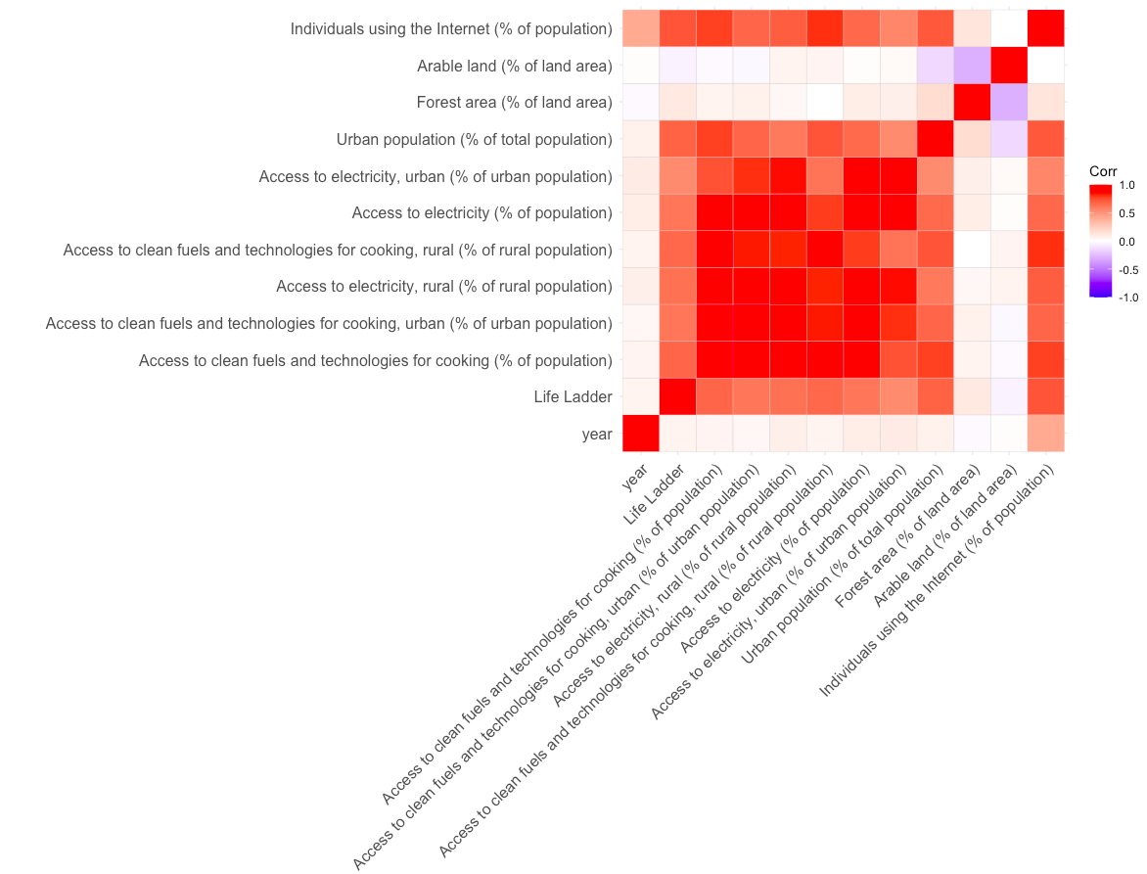
Literature Review
Data Collection & Merge
Final Dataset
Parameter selection
Modeling
Social (13 Variables)
Country
year
Life Ladder
Access to clean fuels and technologies for cooking (% of population)
Access to clean fuels and technologies for cooking, urban (% of urban population)
Access to electricity, rural (% of rural population)
Access to clean fuels and technologies for cooking, rural (% of rural population)
Access to electricity (% of population)
Access to electricity, urban (% of urban population)
Urban population (% of total population)
Forest area (% of land area)
Arable land (% of land area)
Individuals using the Internet (% of population)

Slide 18
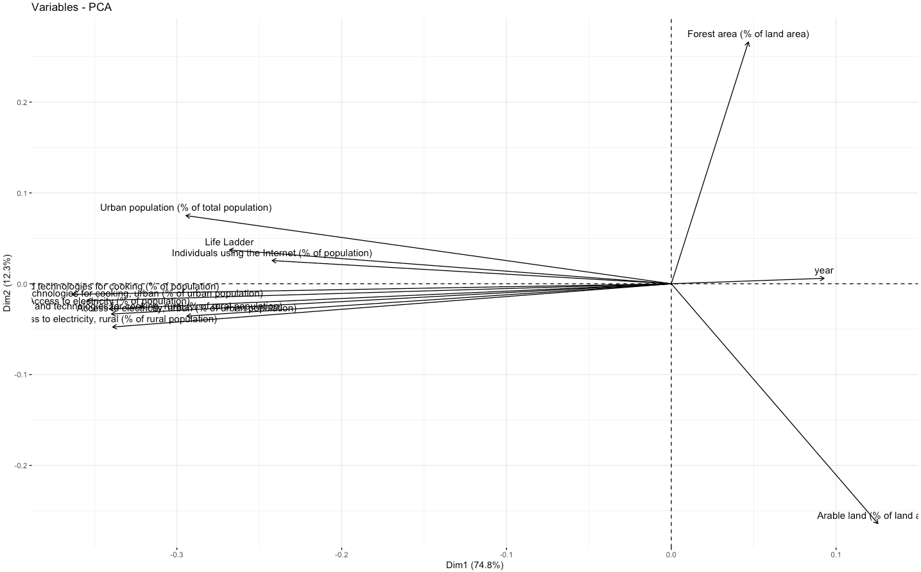
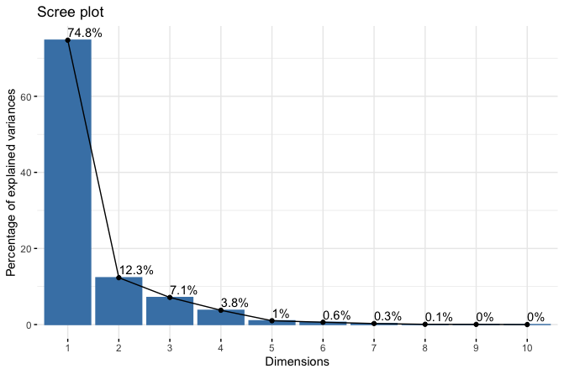
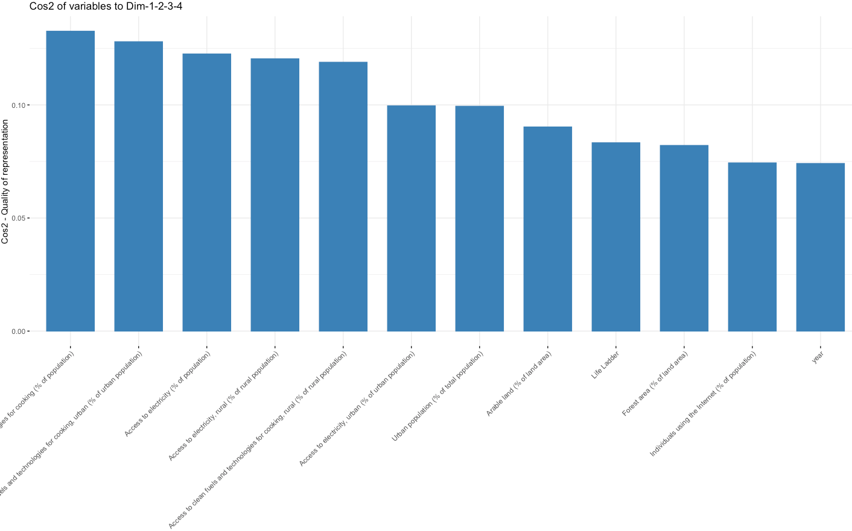
Literature Review
Data Collection & Merge
Final Dataset
Parameter selection
Modeling
Social (13 Variables)

Slide 19
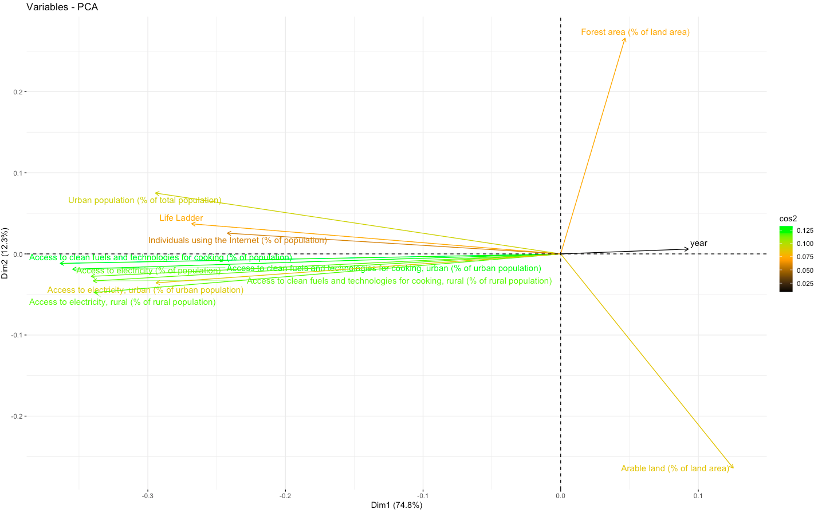
Literature Review
Data Collection & Merge
Final Dataset
Parameter selection
Modeling
Social (13 Variables)
Access to clean fuels
Access to electricity

Slide 20
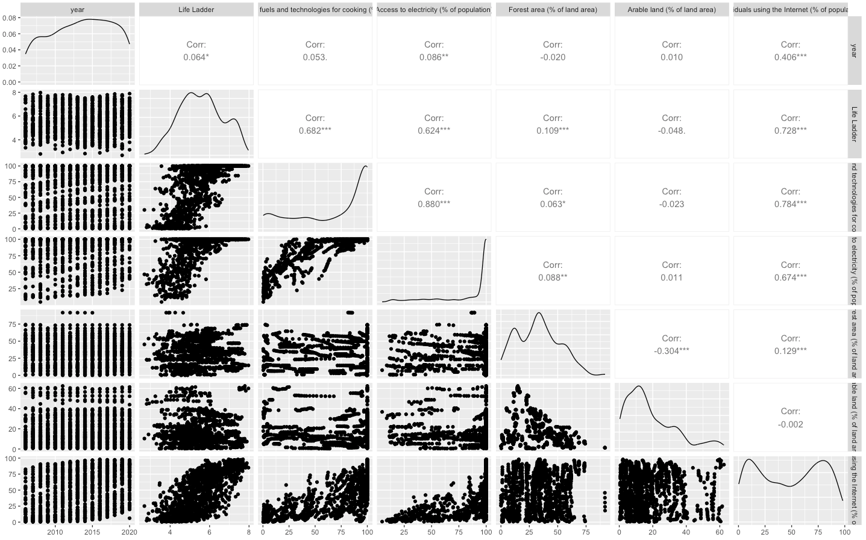
Literature Review
Data Collection & Merge
Final Dataset
Parameter selection
Modeling
Social (8 Variables)

Slide 21
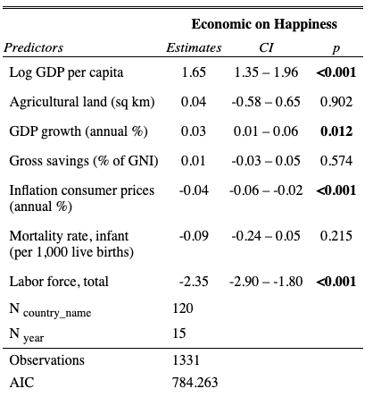
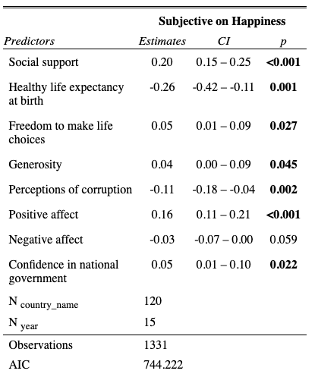
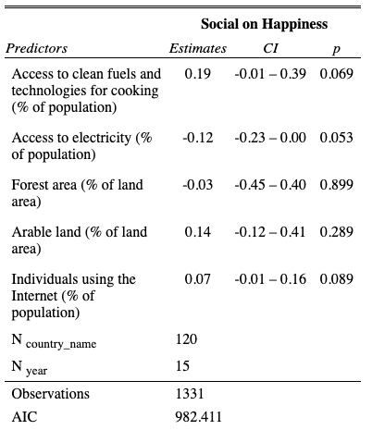
Literature Review
Data Collection & Merge
Final Dataset
Parameter selection
Modeling
Cluster Analysis
Economic (19 Variables)
Citizen opinions (11 Variables)
Social (13 Variables)

Slide 22
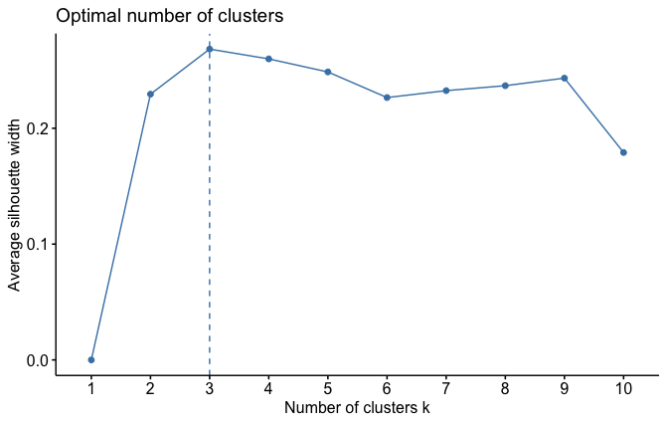
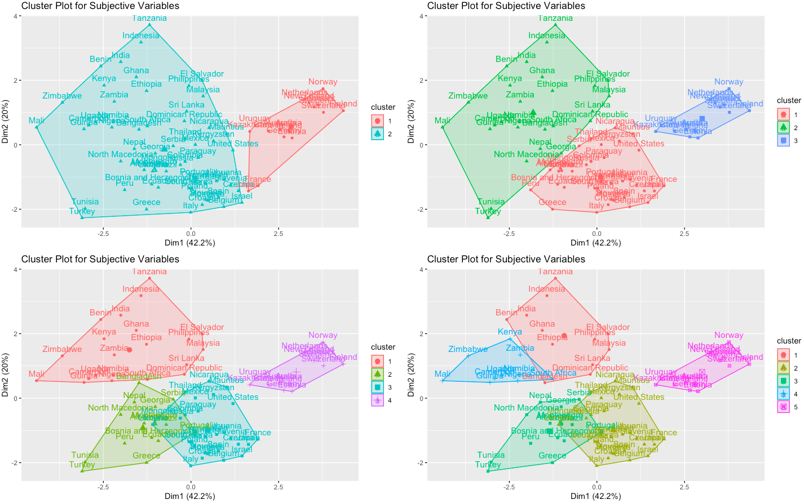
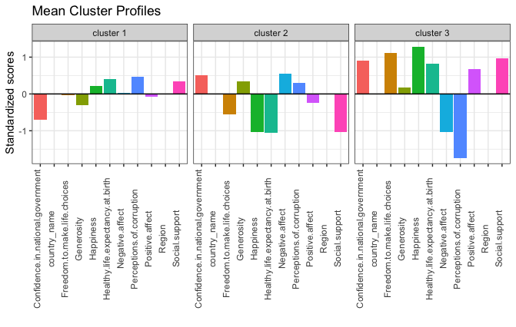
Literature Review
Data Collection & Merge
Final Dataset
Parameter selection
Modeling
Cluster Analysis
Citizen opinions (11 Variables)

Slide 23
Literature Review
Data Collection & Merge
Final Dataset
Parameter selection
Modeling
Cluster Analysis
To be continued

